Slide 1
Application of Machine Learning in Apple Quality Classification

Slide 2
Team Members
Trần Bình Minh (Leader, coordinating and supervising the entire project)
Nguyễn Quang Anh (Data processing and visualization)
Nguyễn Ngọc Tiến (Building and optimizing model)
Tô Thịnh (Model analysis and evaluation)
Lê Danh Tuân (Documentation and presentation)

Slide 3
Overview
Objective: Introduce our project titled "Application of Machine Learning in Apple Quality Classfication."
- Content:
1. Introduction and reasons for choosing the topic.
2. Methods and process of project.
3. Achieved results.
4. Challenges and solutions.
5. Future development directions.
6. Conclusion and thanks.

Slide 4
Introduction
Project Title: Application of Machine Learning in Apple Quality Classification.
Overview:
The objective is to use Machine Learning to classify apple quality, automating the process and make accurate decisions.
This improves classification efficiency and opens up opportunities to optimize the supply chain and increase the value of agricultural products.

Slide 5
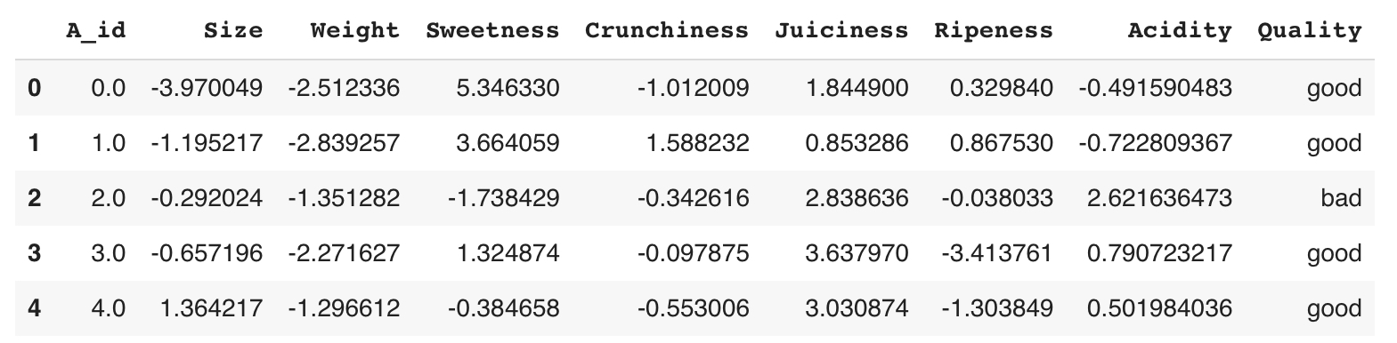
Methods and Process Implementation
Download Dataset:
The dataset was downloaded from Kaggle: apple-quality dataset, containing information about the physical characteristics of apples, such as color, size, and factors affecting quality.

Slide 6
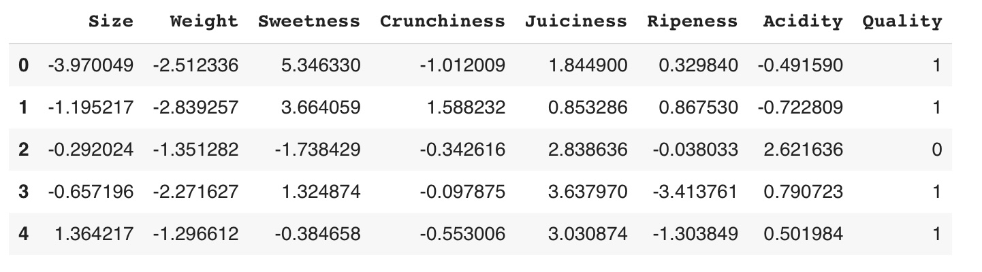
Methods and Process Implementation
Data Pre-processing:
Removed insufficient or unnecessary data points to ensure the model's accuracy.
Converted the data type of the 'Acidity' column to float64 and 'Quality' to binary numbers (0 for bad, 1 for good).

Slide 7
Methods and Process Implementation
Data Visualization:
We used visualizations like heatmaps, scatter plots, and box plots to represent important features.
Identify relationships between features and detect any anomalies in the data.

Slide 8
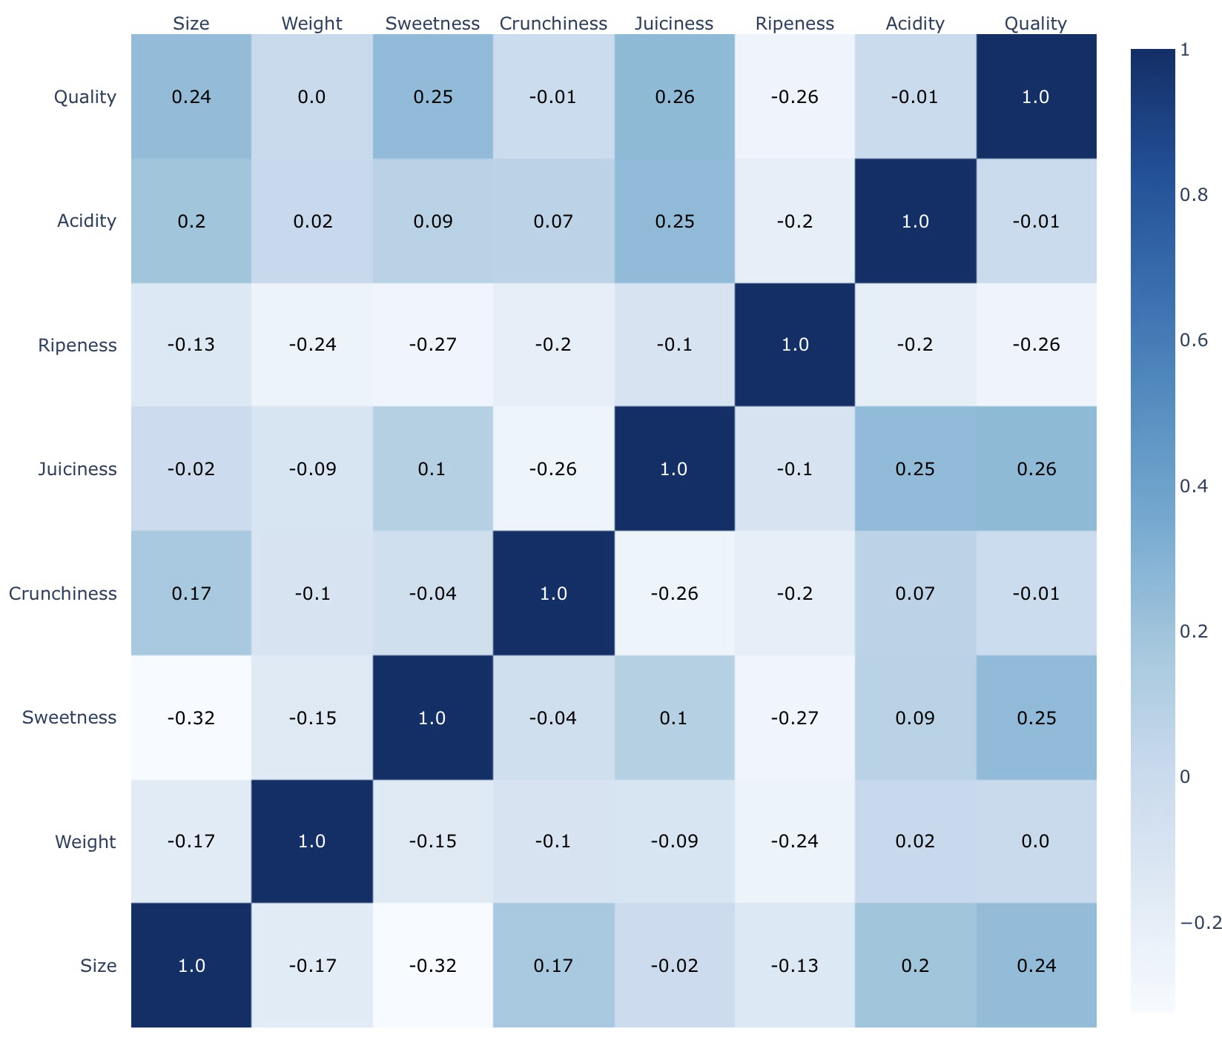

Slide 9
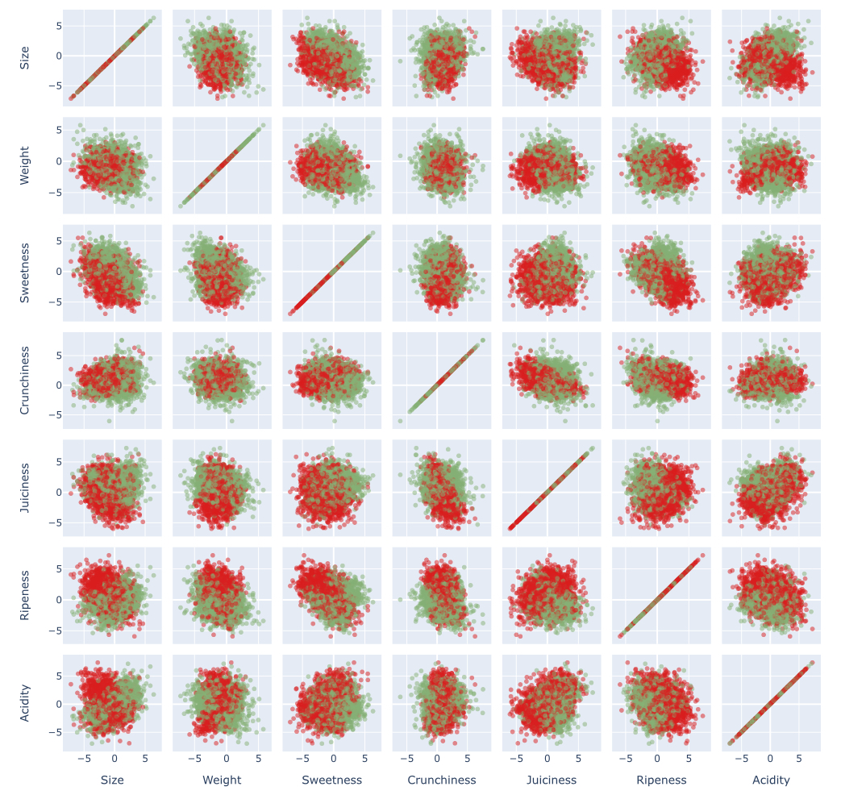

Slide 10
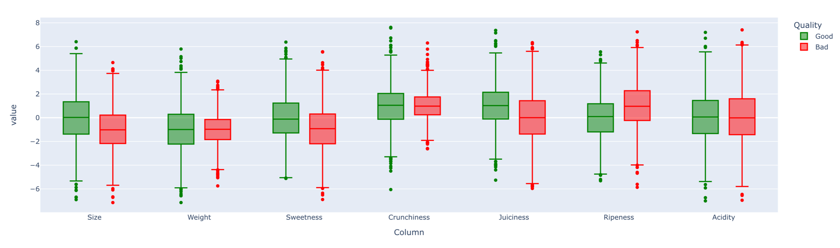

Slide 11
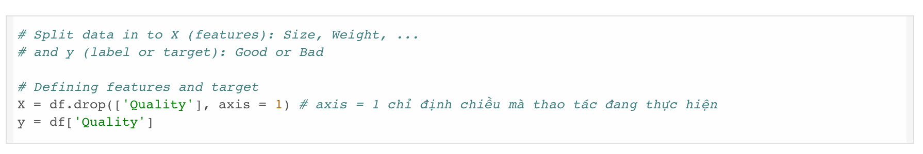
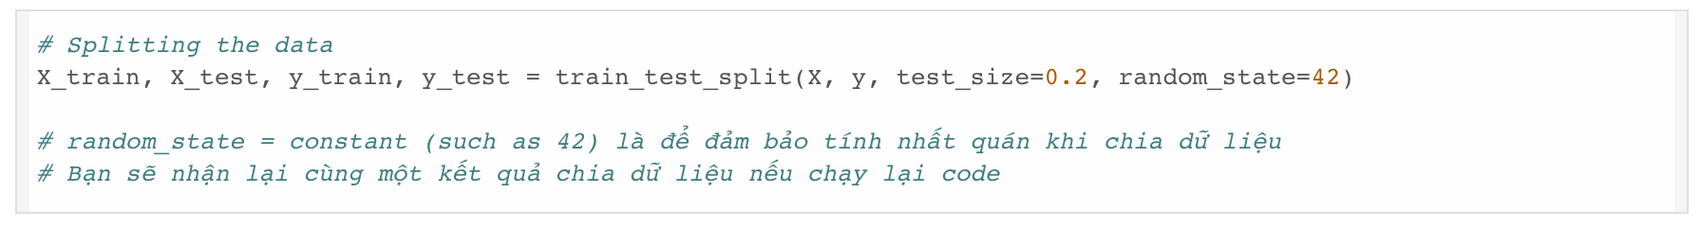
Methods and Process Implementation
Data Splitting:
The data was split into two parts: Features and Label
The data was divided into two parts, with 80% for training and 20% for testing.

Slide 12
Methods and Process Implementation
Random Forest Model Building:
We applied the Random Forest algorithm.
Used the Cross_Val_Score to demonstrate that the model has good generalization capabilities.
The model was trained on the training set and then tested on the test set to evaluate performance.

Slide 13
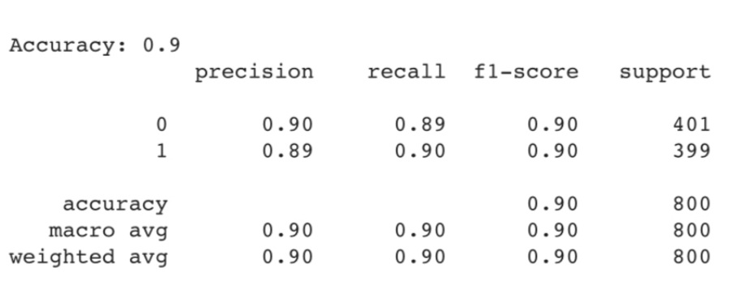
Achieved Results
Model Performance: Accuracy: 0.9
Evaluation Metrics: Metrics like Precision, Recall, and F1-score all reached 0.9 for both classes.

Slide 14
Challenges Encoutered and Solutions
Analysis and Algorithm Selection: Reviewed and evaluated the plots before selecting the appropriate algorithm.
Challenges in Selecting the Algorithm:
We tested several algorithms like Logistic Regression, Naive Bayes, and Decision Trees. After evaluating, we chose Random Forest for its accuracy and ability to reduce overfitting.

Slide 15
Future Development Directions
Model Optimization: Further optimize the model to achieve even higher accuracy.
Algorithm Testing: Experiment with more efficient algorithms to improve Accuracy, Precision, and Recall.
Application Expansion: The model can be extended to classify the quality of other types of agricultural products.

Slide 16
Conclusion and Thanks
Conclusion:
Successfully applied the Random Forest algorithm from the Scikit-learn library to classify apple quality.
Achieved an accuracy of 0.9, with precision, recall, and f1-score all at 0.9.
The results indicate that the model has good generalization capabilities and is not overfitting.
Thanks and Q&A Session

